Slide 1
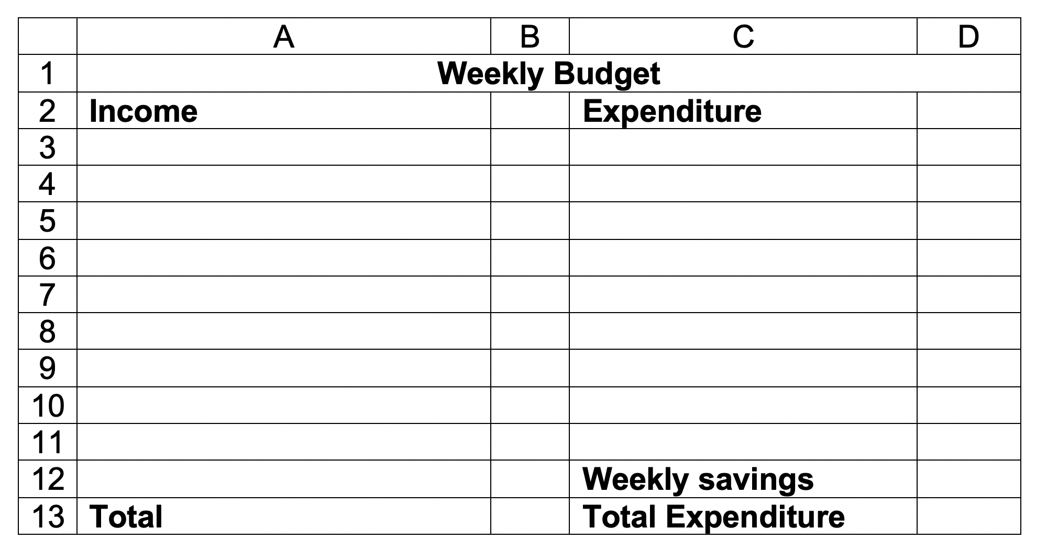
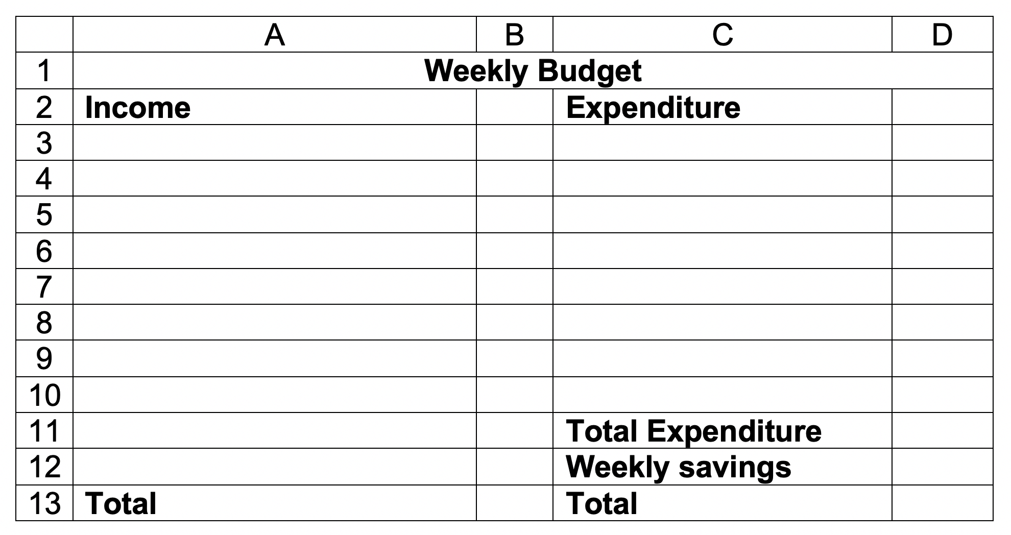
In this table, the Total Expenditure includes the weekly savings.
In this table, the Total Expenditure DOES NOT include the weekly savings.
The total is total expenditure + weekly savings.

